Slide 1
Introduction of Timer control
Prof. Neeraj Bhargava
Kapil Chauhan
Department of Computer Science
School of Engineering & Systems Sciences
MDS University, Ajmer

Slide 2
Timer control
Timer Control plays an important role in the Client side programming and Server side programming, also used in Windows Services.
By using this Timer Control, windows allow you to control when actions take place without the interaction of another thread.

Slide 3
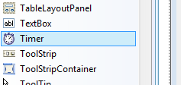
Timer control tools

Slide 4
Use of Timer Control
We can use Timer Control in many situations in our development environment.
At runtime it does not have a visual representation and works as a component in the background.

Slide 5
Properties of Timer Control
Name
It is used to specify name of the Timer Control.
Enabled
It is used to determine weather Timer Control will be enabled or not. It has boolean value true or false. Default value is false.
Interval
It is used to specify interval in millisecond. Tick event of Timer Control generates after the time which is specified in Interval Property.

Slide 6
Methods of the Timer Control
Start
This method is used to start the Timer Control.
Stop
This method is used to stop the Timer Control.

Slide 7
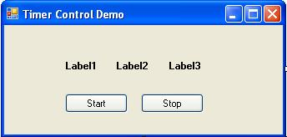
Example
lblHour.Text = Now.Hour lblMinute.Text = Now.Minute lblSecond.Text = Now.Second
Timer1.Start()
Timer1.Stop()

Slide 8
Assignment
Explain properties ,method and event of timer control in vb.net with suitable example.

